Slide 1



Dr. D. Y. Patil Educational Federation’s
DR. D. Y. PATIL COLLEGE OF ENGINEERING AND INNOVATION
Department of Computer Engineering
Project Review III
Project Title: AI-Powered Task Scheduler for Space–Ground Computing
Team Members :
1. Rishikesh Yogesh Boril – 14116
2. Kundan Rajendra Chaudhari – 14118
3. Umesh Ravindra Chaudhari – 14119
4. Vijay Prashant Chavan – 14123
Guide by: Mr. Chandan Wagh
Co-Guide by: Ms. Swapnanjali P. Thorgule
Department of computer Engineering
1
Varale, Talegaon, Pune Campus

Slide 2


Content
Problem Statement
Objectives of Project
Scope of the Project
Literature Review
Proposed Methodology
System Design
Tools and Technology
Algorithm
UML Class Diagram
UML Sequence Diagram
UML Use Case Diagram
References
Conclusion

Slide 3
Problem Statement
When satellites capture massive amounts of data in orbit, sending everything back to Earth for processing is slow, costly, and energy-intensive.But processing everything in space is also not practical because satellite power and compute are limited.
So, the big problem is : “ Where should each AI task run in space or on the ground to minimize cost, latency, and power?”

Slide 4
Objectives of Project
Our main goals are:
To create an intelligent AI scheduler that decides where jobs should run (Earth or space).
To make these decisions based on important trade-offs like cost, speed, and power.
To have the AI explain why it made its choices, so a person can understand them.
To build a user-friendly website to show all of this in a clear way.

Slide 5
Scope of the Project
This project will build a proof of concept. It will not use real satellites but will instead use a very realistic simulation of them. Our focus is on the smart scheduling and the user interface, not on building actual space hardware. We will show that our idea works and is a good solution for the future.

Slide 6
Literature Review
Sr.No | Author(s) | Year | Title / Source | Focus Area
1 | Gupta, R. P. | 2025 | How Generative AI Can Revolutionize Project Scheduling (INDIAai) | GenAI in scheduling
2 | Jaimes & Coello Coello | 2025 | Multi-Objective Evolutionary Algorithms | Search strategies
3 | Huynh, C. | 2025 | AI on the Edge of Space (CSET) | Onboard AI agents & explainability
4 | Pratt, Bostian & Allnutt | 2021 | Satellite Communications | Orbital mechanics
5 | Pelton, J. N. | 2024 | The New Space Race | Space policy & strategy
6 | Maral & Bousquet | 2022 | Satellite Communications Systems | Link analysis

Slide 7
Proposed Methodology
Task Submission
Analyze the Task
The Intelligent Decision
Apply Algorithms
Execution (in the Simulation)
Make the Smart Choice
Result and Explanation

Slide 8
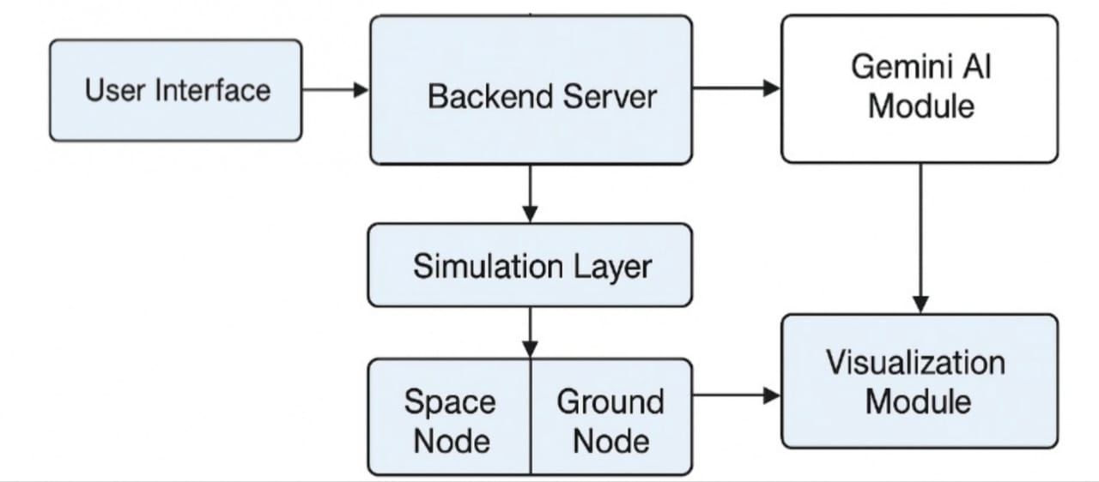
System Architecture

Slide 9
Tools &Technologies
We'll use modern, powerful tools that are mostly free:
Backend: Python and the FastAPI framework.
Frontend: JavaScript and the React framework.
AI: The Google Gemini API for our GenAI brain.
Simulation Engine: Python , Skyfield.
Libraries: Plotly.js for charts and Matplotlib.
Database: Mongodb.

Slide 10
Algorithm
Steps:
Step 1: Start Step 2: User submits a task with attributes → TaskName, Compute, DataSize, Urgency. Step 3: Backend receives task and queries simulation system for satellite & ground node status. Step 4: Simulation system returns resource info (latency, power, cost, availability). Step 5: Backend prepares a structured prompt and sends it to the GenAI model.

Slide 11
Algorithm
Step 6: GenAI analyzes the input and returns the best execution node (Space or Ground). Step 7: Validate AI decision using mathematical rules or Genetic Algorithm. Step 8: Store task and decision in the database. Step 9: Display result on dashboard (pie chart, table, etc.). Step 10: End

Slide 12
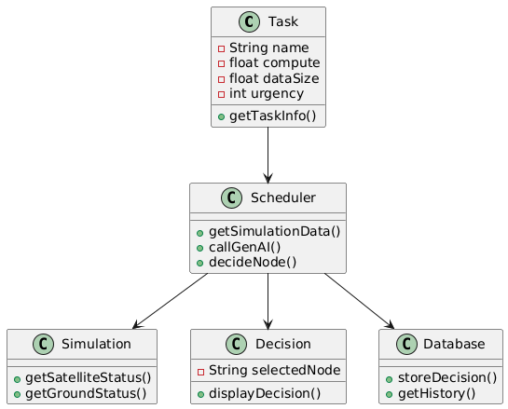
UML Class Diagram

Slide 13
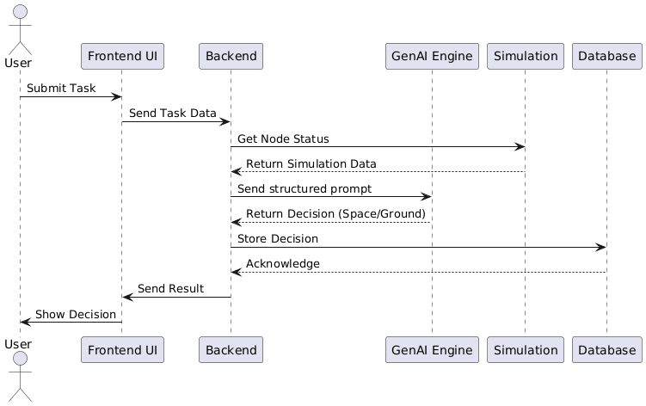
UML Sequence Diagram

Slide 14
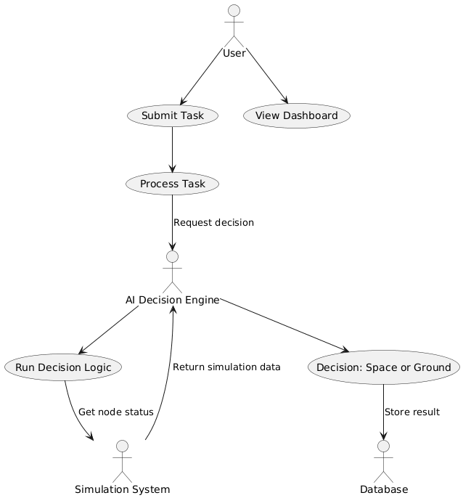
UML Use Case Diagram

Slide 15
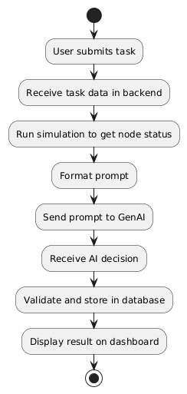
Uml Activity Diagram

Slide 16
References
[1] Gupta, R. P. (2025). How Generative AI Can Revolutionize Project Scheduling. INDIAai. (Section: Conceptual Overview of GenAI in Scheduling)
[2] Jaimes, A. L., & Coello Coello, C. A. (2025). Multi-Objective Evolutionary Algorithms: A Review of the State-of-the-Art. (Section: Review of Search Strategies)
[3] Huynh, C. (2025). AI on the Edge of Space: Securing Space Superiority and Avoiding Surprise in Orbit. CSET. (Section: Onboard AI Agents and Explainability)
[4] Pratt, T., Bostian, C., & Allnutt, J. (2021). Satellite Communications. (Chapter 2: Orbital Mechanics and Launchers)
[5] Pelton, J. N. (2024). The New Space Race. (Section: Thematic Takeaways for Space Policy and Strategy)
[6] Maral, G., & Bousquet, M. (2022). Satellite Communications Systems. (Chapter 1: Introduction to Link Analysis)
[7] Shi, Y., et al. (2025). Satellite Edge Artificial Intelligence with Large Models: Architectures and Technologies. arXiv. (Section: Onboard Data Processing and Distributed Processing)
[8] Utsav, A. P., & Álvarez, R. R. (2025). Space Edge Computing for Satellite Systems: Definition and Key Enabling Technologies. ResearchGate. (Section: Definition and Key Enabling Technologies)
[9] Chen, S., et al. (2024). AI and Edge Computing: Synergistic Approaches for Real-time Data Processing in Cloud Environments. IRE Journals. (Section: Synergistic Approaches)
[10] Kumar, B. P. N., & Venkatesha, M. G. (2025). A Review of Dynamic Scheduling Algorithms for Homogeneous and Heterogeneous Systems. ResearchGate. (Section: Review of Dynamic Scheduling)

Slide 17
Conclusion
The AI-Powered Task Scheduler for Space–Ground Computing efficiently distributes satellite tasks between space and ground nodes using Gemini AI. It analyzes task parameters like compute, data size, and urgency to make intelligent decisions that optimize latency, power, and cost. The system demonstrates how Generative AI can enhance autonomous space operations, making future satellite missions more efficient and adaptive.

Slide 18
Thank You!

